Slide 1




Database Management System for Water Tanker Booking & Delivery
Presented by: Chandrahas Thunga | Roll No: 25WU0102284

Slide 2
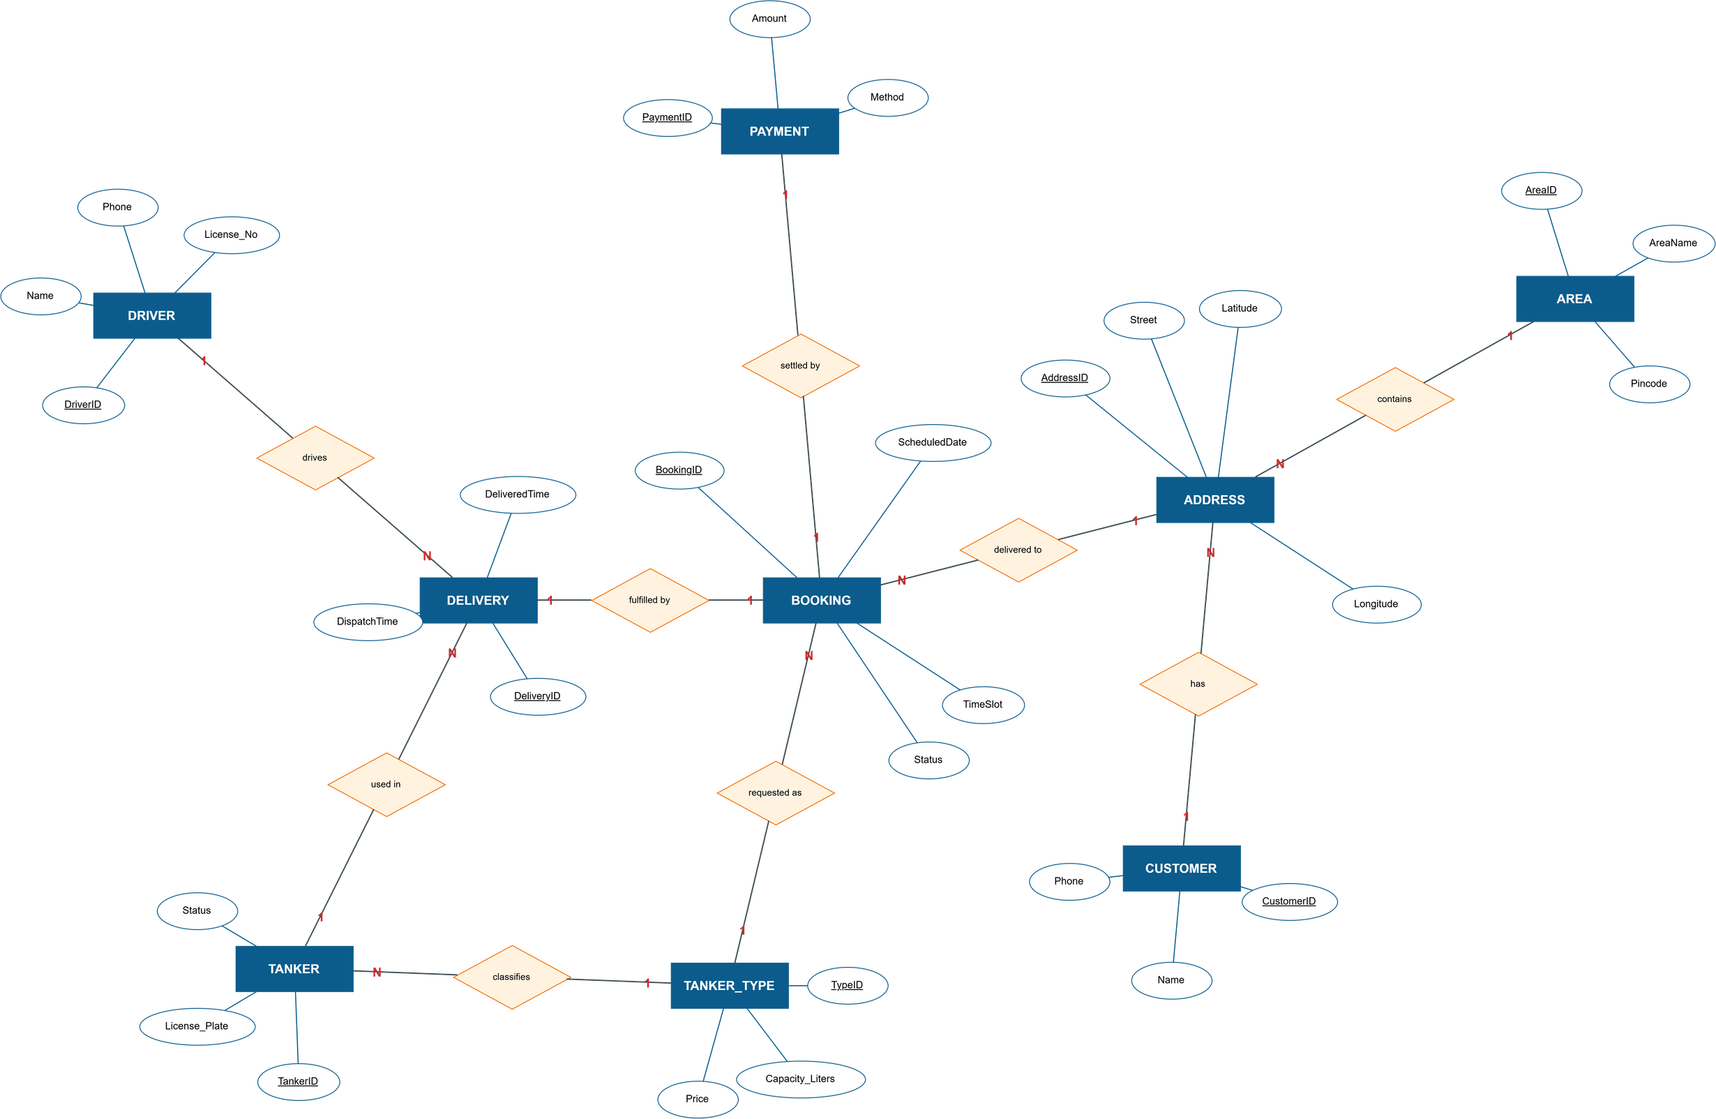
ER Diagram

Slide 3
Thank You!

